Slide 1

Applications of XML Pipelines
XML Prague, June 16th, 2007
Erik Bruchez
ebruchez@orbeon.com

Slide 2
XPL and XProc

Slide 3
History
XPL stands for XML Pipeline Language
2002: Developed by A. Vernet and myself
2004: Implementation open source (LGPL)
2005: Specification for XPL at W3C
We now participate in the XProc Working Group at W3C

Slide 4
Shared Features
Same goal: performing sequences of operations on XML documents
XML-based syntax
Exchange of XML documents between "steps"
Steps with multiple inputs and outputs
Iterations and conditionals

Slide 5
New in XProc
Exception handling
Viewports
Sequences of documents between steps
Parameters and options
Standard step library

Slide 6
XProc as a Superset of XPL
Most XPL pipelines can be transformed into XProc with XSLT stylesheet (provided that the same steps are available on both sides)
A subset of XProc can be implemented on top of XPL with XSLT

Slide 7
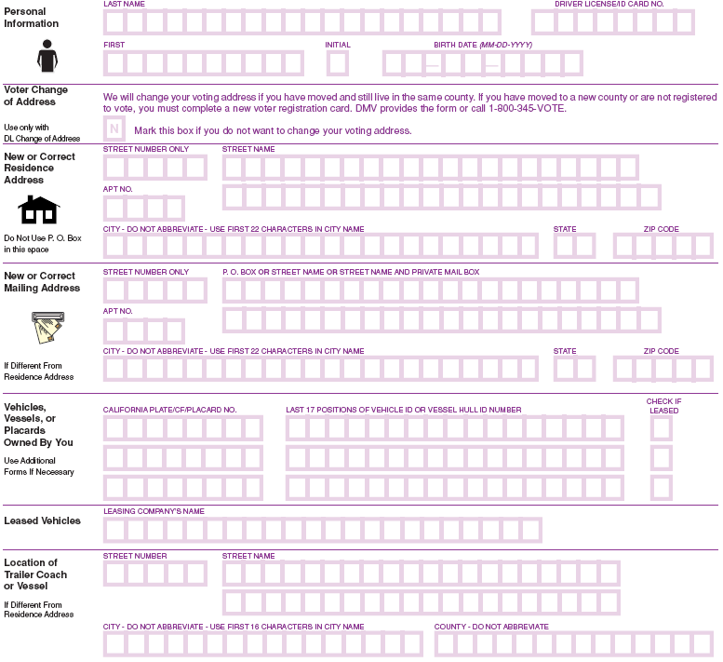
XPL and Orbeon Forms

Slide 8
Orbeon Forms
Open source platform
Evolution
  general-purpose XML transformation platform
  web presentation platform
  forms solution

Slide 9
XPL in Orbeon Forms
MVC architecture
Configurable post-processing
Ajax server hooking-up to the XForms engine
Lightweight REST services callable from XForms submissions

Slide 10
XML Pipelines and MVC

Slide 11
MVC Architecture
Separates data and presentation
  Model
  View
  Controller

Slide 12
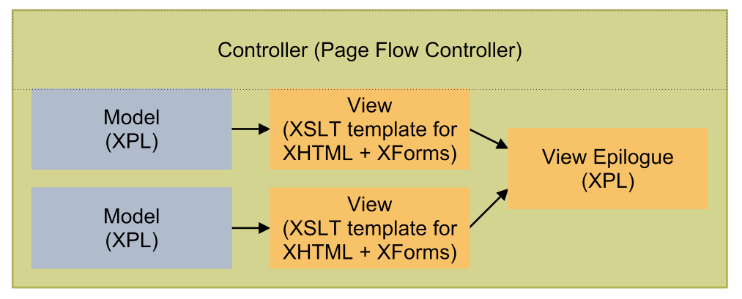
Controller Pipeline

Slide 13
Example
"request" step extracts a portion of the URL path
"choose" step contains one "when" branch per path to process
Each branch
  Calls "model" sub-pipeline step
  Calls "view" sub-pipeline (stylesheet or XHTML+XForms)
"serialize" step sends result to the browser

Slide 14
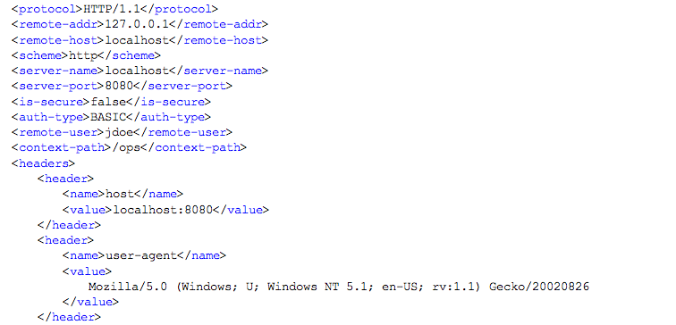
Request Step

Slide 15
Controller Language
<page id="view-account"
path-info="/atm-view-account"
model="view-account-model.xpl"
view="view-account-view.xhtml"/>

Slide 16
Document Types
&
Client Capabilities

Slide 17
Post-Processing
Pseudo-HTML document
XHTML document
  Supported by client
  Not supported by client
XHTML + XForms
  Supported by client
  Not supported by client

Slide 18
Other Document Types
XSL-FO
Atom and RSS
Text and binary
Other XML documents

Slide 19
Epilogue Pipeline
Leverages conditionals
  Root element
  Other (xforms:model)
Configurable and expandable
Notes:
Show pipeline and demo of XHTML vs. HTML production

Slide 20
Portal Environment
Full HTML document
HTML fragment

Slide 21
REST

Slide 22
Typical REST Service
Receives XML from client
Returns back XML
Variations on the payload
  JSON
  HTML
  plain text / custom formats

Slide 23
REST with Pipelines
Rich enough steps (components)
  “request” component
  “response” or “serialization” component
  XSLT does a lot already!

Slide 24
Search Results
"request" step extracts data submitted by client
"validation" step validates the posted data
"SQL" step calls relational database
"serialize" step serializes XML to HTTP

Slide 25
Adapter Service
"request" step extracts POSTed data
"http" step calls service with the extracted data.
"XSLT 2.0" step (regexps)
  extracts data returned by service
  format XML response
"serialize" step serializes XML to HTTP

Slide 26
Ajax

Slide 27
Ajax Server
Server part is just REST service
Can be implemented natively
Plumbing with pipelines ☺

Slide 28
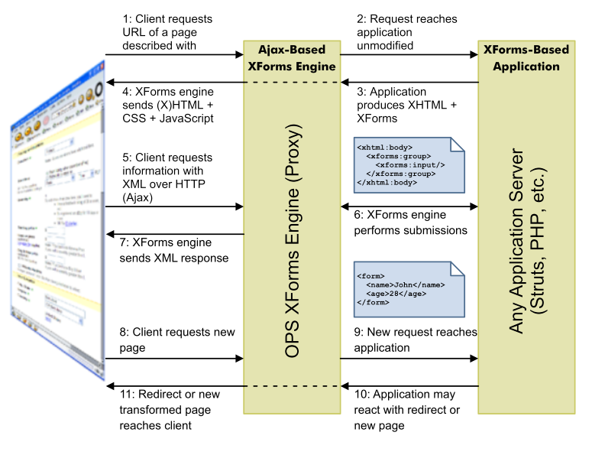
Ajax-Based XForms

Slide 29
Ajax XForms Server
"request" step extracts request headers and HTTP method.
Request is an HTTP POST
  "request" step extracts body and exports as a URI
  "generator" step dereferences URI and parses as XML
  Payload validated with Relax NG
  "XForms server" step receives the XML payload
  Response validated with Relax NG
  "serializer" step serializes response to HTTP as XML

Slide 30
Ajax XForms Server (cont.)
Request is a pseudo-Ajax submission
  "request" step extracts request parameters
  "XSLT" step formats parameters into an XML document
  Payload validated with Relax NG
  "XForms server" step receives the XML payload
  Response validated with Relax NG
  "XSLT" step embeds XML into small XHTML document
  "serializer" step serializes response to HTTP as XML

Slide 31
Cross-Domain Proxies
"request" step obtains relevant request data
"http" step forwards the step to an external service
Forward the response back to the browser through HTTP

Slide 32
Pipelines and XForms

Slide 33
XForms Submissions
xforms:submission
Serializes XML instance data
Submits the serialization with a protocol
XML data can be returned as well
XForms 1.1 specifies http, https, file, and mailto
SOAP serialization
Implementation could define serializations to and from JSON over HTTP

Slide 34
XForms 1.1
Extends 1.0 HTTP and HTTPS support
Intent to support REST interfaces
XForms applications natively talk with RESTful services that speak XML

Slide 35
Impedance Mismatch
Missing
  REST
  XML
  SOAP support
XML pipelines = impedance adapters

Slide 36
Transformations
XForms does not directly support XSLT 2.0 or XQuery
Transformations can be implemented in XML pipelines called from an XForms submission

Slide 37
i18n
XForms resources
  As XML instances
  Loaded during initialization
Static resources
  from web server
Database, etc.
  impedance mismatch solved with pipelines

Slide 38
Conclusion
XML pipelines can play the role of a glue
Putting together web apps out of XML
XProc makes one more component of this architecture a standard
Last missing piece of the puzzle: standard specification for a web application controller!

